Slide 1

Peer-to-Peer Computing and Structured Overlay Network
Dhruvi Mehta – 19125010
Veer Shah - 19125052

Slide 2
Introduction
Peer-to-peer (P2P) network: application-level organization of the network overlay for flexibility sharing resources (e.g., files and multimedia documents) stored across network-wide computers.
All nodes (called peers) are equal i.e. client as well as server;
communication directly between peers (no client-server)
Allows to find location of arbitrary objects; no DNS servers required
Sharing of Large combined storage, CPU power, other resources, without scalability costs
Dynamic insertion and deletion of nodes called churn, as well as of resources, at low cost
Overlay networks: Overlay networks refer to networks that are
constructed on top of another network (e.g. IP).
P2P overlay network: Any overlay network that is constructed by the Internet peers in the application layer on top of the IP network.

Slide 3
Desirable Characteristics of P2P
Features | Performance
Self-organizing | Large combined storage, CPU power, and resources
Distributed control | Fast search for machines and data objects
Role symmetry for nodes | Scalable
Anonymity | Efficient management of churn
Naming mechanism | Selection of geographically close servers
Security, authentication, trust | Redundancy in storage and paths
Table I: Desirable characteristics and performance features of P2P systems.

Slide 4
Application Layer Overlays
A core mechanism in P2P networks is searching for data, and this mechanism depends on how (i) the data, and (ii) the network, are organized.
Search algorithms for P2P networks tend to be data-centric, as opposed to the host-centric algorithms for traditional networks.
P2P search uses the P2P overlay, which is a logical graph among the peers that is used for the object search and object storage and management algorithms.
Note that above the P2P overlay is the application layer overlay, where communication between peers is point-to- point (representing a logical all-to-all connectivity) once a connection is established.

Slide 5
Classification of P2P Overlay Network

Slide 6
Unstructured
P2P Overlay Network
Structured
DHT
Non DHT
Non Deterministic
Deterministic
CAN
Mercury
Gnutella
Napster
CHORD
Kazaa
BitTorrent
Tapestry
JXTA
Pastry
Kademila
Figure: Classification of P2P Overlay Network

Slide 7
Classification of P2P Overlay Network
The P2P overlay can be (i) structured (e.g., hypercubes, meshes, butterfly networks, de Bruijn graphs) or (ii) unstructured, i.e., no particular graph structure is used.
Structured overlays use some rigid organizational principles based on the properties of the P2P overlay graph structure, for the object storage algorithms and the object search algorithms.
Unstructured overlays use very loose guidelines for object storage. As there is no definite structure to the overlay graph, the search mechanisms are more “ad-hoc,” and typically use some forms of flooding or random walk strategies.
Thus, object storage and search strategies are intricately linked to the overlay structure as well as to the data organization mechanisms.

Slide 8
Structured vs. Unstructured Overlays
Structured Overlays:
Structure ⇒ placement of files is highly deterministic, file insertions and deletions have some overhead
Fast lookup
Hash mapping based on a single characteristic (e.g., file name)
Range queries, keyword queries, attribute queries difficult to support
Unstructured Overlays:
No structure for overlay ⇒ no structure for data/file placement
Node join/departures are easy; local overlay simply adjusted
Only local indexing used
File search entails high message overhead and high delays
Complex, keyword, range, attribute queries supported
Examples: FreeNet, Gnutella, KaZaA, BitTorrent
Examples:
Content
Chord, Addressable
Network(CAN), Pastry.

Slide 9
Data Indexing
Data identified by indexing, which allows physical data independence from
apps.
Centralized indexing: e.g., versions of Napster, DNS
Distributed indexing: Indexes to data scattered across peers. Access data through mechanisms such as Distributed Hash Tables (DHT). These differ in hash mapping, search algorithms, diameter for lookup, fault tolerance, churn resilience.
Local indexing: Each peer indexes only the local objects. Remote objects need to be searched for. Typical DHT uses flat key space. Used commonly in unstructured overlays (E.g., Gnutella) along with flooding search or random walk search.
Another classification:
Semantic indexing: human readable, e.g., filename, keyword, database key. Supports keyword searches, range searches, approximate searches.
Semantic-free indexing: Not human readable. Corresponds to index
obtained by use of hash function.

Slide 10
Structured Overlays: Distributed Hash Tables

Slide 11
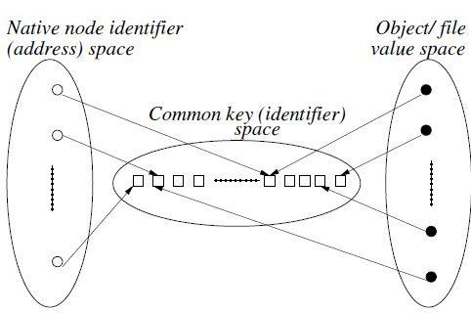
Simple Distributed Hash Table scheme
Mappings from node address space and object space in a simple DHT. Highly deterministic placement of files/data allows fast lookup. But file insertions/deletions under churn incurs some cost.
Attribute search, range search, keyword search etc. not possible.

Slide 12
Chord Distributed Hash Table: Overview
The Chord protocol, proposed by Stoica et al. (2003), uses a flat key space to associate the mapping between network nodes and data objects / files /values.
The node address as well as object value is mapped to a logical identifier in a common flat key space using a consistent hash function.
When a node joins or leaves the network of n nodes, only O(1/n) keys have to be moved from one location to another.
Two steps involved:
Map the object value to its key
Map the key to the node in the native address space using lookup
Common address space is a m-bit identifier (2^{m} addresses), and this space is arranged on a logical ring mod (2^{m} ).
A key k gets assigned to the first node such that the node identifier equals or is greater than the key identifier of k in the common identifier space. The node is the successor of k, denoted succ(k).

Slide 13

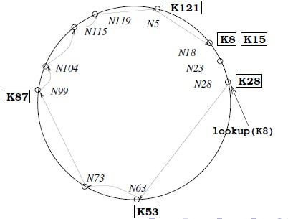
Example
A Chord ring for m = 7 is depicted in figure. Nodes N5, N18, N23, N28, N63, N73, N99, N104, N115, and N119 are shown. Six keys, K8, K15, K28, K53, K87, and K121, are stored among these nodes using succ(k) as follows:
succ8 = 18, succ15 = 18, succ28 = 28, succ53 = 63, succ87 = 99, and succ121 = 5.
A key k gets assigned to the first node such that the node identifier equals or is greater than the key
identifier of k in the common identifier space. The node is the successor of k, denoted succ(k).

Slide 14
Chord: Simple Lookup
(variables)
integer: successor ← initial value;
(1) i.Locate_Successor (key ), where key ƒ= i: (1a) if key ∈ (i, successor ] then
(1b) return(successor )
(1c) else return successor.Locate _Successor(key ).
Each node tracks its successor
on the ring.
Query for key x is forwarded on the ring until reaches first node whose identifier y ≥ key (x mod (2^{m})).
The result, node with key y, is returned to the querying node (along the reverse of the path
that was followed by the query.)
This mechanism requires O(1) local space but O(n) hops.

Slide 15
Chord: Scalable Lookup
Each node i maintains a routing table, called the finger table, with O(log n) entries, such that the x th entry (1 ≤ x ≤ m) is the node identifier of the node succ (i + 2^{x−1}).
denoted by
i .finger [x ] = succ (i + 2^{x−1}).
This is the first node whose key is
greater than the key of
node i by at least 2^{x−1} mod 2^{m} .
Complexity: O(log n) message hops at the cost of O(log n) space in the local routing tables
Due to the log structure of the finger table, there is more info about nodes closer by than about nodes further away.

Slide 16
Contd…
Consider a query on key key at node i ,
. if key lies between node i and its successor, the key would reside at the successor and its address is returned.
. If key lies beyond the successor, then node i searches through the m entries in its finger table to identify the node j such that j most immediately precedes key , among all the entries in the finger table.
. As node j is the closest known node that precedes key, j is most likely to have the most information on locating key , i.e., locating the immediate successor node to which key has been mapped.

Slide 17
Chord: Scalable Lookup Procedure
(variables)
integer: successor ← initial value;
integer: predecessor ← initial value;
array of integer finger [1 . . . log n];
i.Locate Successor (key ), where key = i: (1a) if key ∈ (i, successor ] then
(1b) return(successor )
(1c) else
(1d) j ← Closest _Preceding _Node(key ); (1e) return j.Locate _Successor (key ).
i.Closest_Preceding_Node(key ), where key = i: (2a) for count = m down to 1 do
(2b)
(2c)
if finger [count] ∈ (i, key ] then
break();
(2d) return(finger [count]).
Algorithm 2: A scalable object location algorithm in Chord at node i.

Slide 18
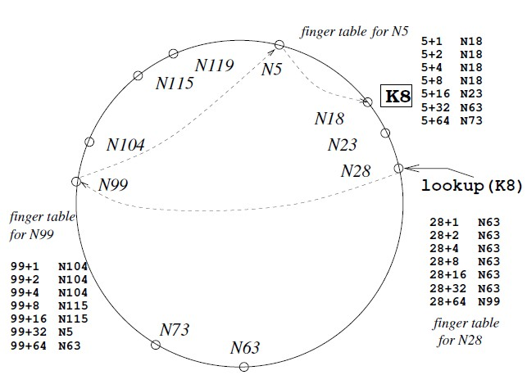
Chord: Scalable Lookup Example
Example: The use of the finger tables in answering the query lookup(K8)at node N28 is illustrated in figure. The finger tables of N28, N99, and N5 that are used are shown.

Slide 19
Managing Churn: Node joins
The code to manage dynamic node joins, departures, and failures is given in the Algorithm 3 of managing churn
Node joins:
To create a new ring, a node i executes Create_New_Ring which creates a ring with the singleton node. To join a ring that contains some node j, node i invokes Join_Ring(j).
Node j locates i’s successor on the logical ring and informs i of its successor. Before i can participate in the P2P exchanges, several actions need to happen: i’s successor needs to update its predecessor entry to i, i’s predecessor needs to revise its successor field to i, i needs to identify its predecessor, the finger table at i needs to be built, and the finger table of all nodes need to be updated to account for i’s presence.
This is achieved by procedures Stabilize(), Fix_Fingers(), and
Check_Predecessor() that are periodically invoked by each node.

Slide 20
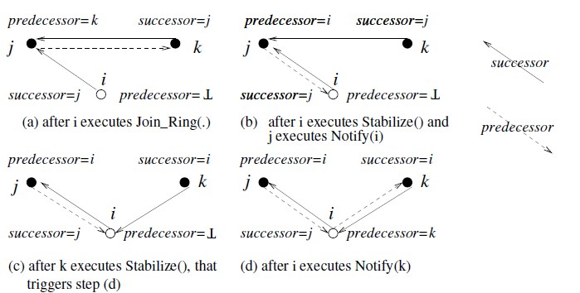
Contd…
The Given Figure: Illustrates the main steps of the joining process. A recent joiner node i that has executed Join_Ring(·) gets integrated into the ring by the following sequence:
Figure: Steps in the integration of node i in the ring, where j > i > k

Slide 21
Contd…
Once all the successor variables and finger tables have stabilized, a call by any node to Locate_Successor(·) will reflect the new joiner i.
Until then, a call to Locate_Successor(·) may result in the
Locate_Successor(·) call performing a conservative scan.
The loop in Closest_Preceding_Node that scans the finger table will result in a search traversal using smaller hops
rather than truly logarithmic hops, resulting in some
inefficiency.
Still, the node i will be located although via more hops.

Slide 22
Managing Churn: Node failures and departures
Node failures and departures:
When a node j fails abruptly, its successor i on the ring will discover the
failure when the successor i executes Check_Predecessor () periodically.
Process i gets a chance to update its predecessor field when another node k causes i to execute Notify(k). But that can happen only if k’s successor variable is i.
This requires the predecessor of the failed node to recognize that its successor has failed, and get a new functioning successor.
In fact, the successor pointers are required for object search; the
predecessor variables are required only to accommodate new joiners.
Note from Algorithm 3 that knowing that the successor is functional, and that the nodes pointed to by the finger pointers are functional, is essential.

Slide 23
Algorithm 3: Managing churn in Chord. Code shown is for node i
(variables)
integer: successor ← initial value; integer: predecessor ← initial value; array of integer finger [1 . . . log m]; integer: next finger ←1; (1)i.Create_New_Ring ():
(1a) predecessor ←⊥; (1b) successor ← i .
i.Join_Ring (j), where j is any node on the ring to be joined:
(2a) predecessor ←⊥;
(2b) successor ←j.Locate_Successor (i ).
i.Stabilize(): // executed periodically to verify and inform successor
(3a) x ← successor.predecessor ; (3b) if x ∈ (i, successor ) then (3c) successor ← x ;
(3d) successor.Notify (i ).

Slide 24
Contd…
(4)i.Notify (j): // j believes it is predecessor of i
(4a) if predecessor =⊥ or j ∈ (predecessor , i )) then
(4b)
(4c)
transfer keys in the range [j, i] to j; predecessor ← j.
i.Fix_Fingers():// executed periodically to update the finger table
5a) next_finger ← next_finger + 1;
(5b) if next_finger > m then
(5c) next_finger ← 1;
(5d) finger [next_finger ] ← Locate_Successor (i + 2^{next _finger−1} ).
i.Check_Predecessor (): // executed periodically to verify whether
//predecessor still exists
(6a) if predecessor has failed then
(6b) predecessor ←⊥.

Slide 25
Complexity
For a Chord network with n nodes, each node is responsible for at most (1 + ϵ)K/n keys, with “high probability”, where K is the total number of keys.
Using consistent hashing, ϵ can be shown to be bounded by
O(logn).
The search for a successor Locate_Successor in a Chord network
with n nodes requires with high probability.
time complexity O(log n)
The
size of the finger table is log (n) ≤ m
The
average lookup time is 1/2 log (n).

Slide 26
Comparison of Structure P2P Overlay Network (1)
Algorithm | Overlay Network Topology | Distance from i to j | Routing path length
Chord | One-dimensional ring | (j − i) mod 2^{m} | O(logN)
CAN | d-dimensional cube | Euclidean distance | (d/4) N^{1/d}
GISP | Structureless | objects: the difference of the two IDs; nodes: (i,j)/(2^{st-1}2^{sj-1}); si, sj are “peer strength” | uncertain
Kademila | XOR-tree | i ⊕ j | O(log2b N)
Pastry | Tree + ring | assessed digit by digit | O(log2b N)
Tapestry | Tree | same as Pastry | O(log2b N)
Viceroy | Butterfly | (j − i) mod 1 | O(logN)
Source: “A Survey on Distributed Hash Table (DHT): Theory, Platforms, and
Applications”, Hao Zhang, Yonggang Wen, Haiyong Xie, and Nenghai Yu., 2013

Slide 27
Comparison of Structure P2P Overlay Network(2)
Algorithm | Routing path selection | # of maintained peers | Node’s joining | Node’s leaving
Chord |  | O(log2 N) | Find successor; construct finger table | Run stabilization protocol periodically
CAN |  | 2d | Generate neighbor list | Update neighbor lists
GISP |  | as many as possible | Generate routing list | Delete failing nodes from routing list
 | Greedy Algorithm | at most 160 × k(O(log2 N)) | Constructs k- buckets | Detect the target node before routing
Kademila
 |  |  | Generate routing table, neighbor- hood set and a namespace set | Detect the target node before routing
Pastry |  | O(log2b N)
Tapestry |  | O(log2b N) | Construct the routing table | Heartbreak message
Viceroy |  | at most 7 | Construct the three kinds of links | Repaired by the LOOKUP operation

Slide 28
Conclusion
Peer-to-peer (P2P) networks allow equal participation and resource sharing among the users.
This lecture first give the basic fundamentals and underlying concepts of P2P networks. i.e. (i) Structured P2P networks and (ii) Unstructured P2P networks
Then we have discussed the concept of ‘Distributed Hash Table’ and DHT based classical structured P2P network i.e. Chord

